Slide 1
How to Use Movie Studio Platinum
By: Aiden Smith

Slide 2
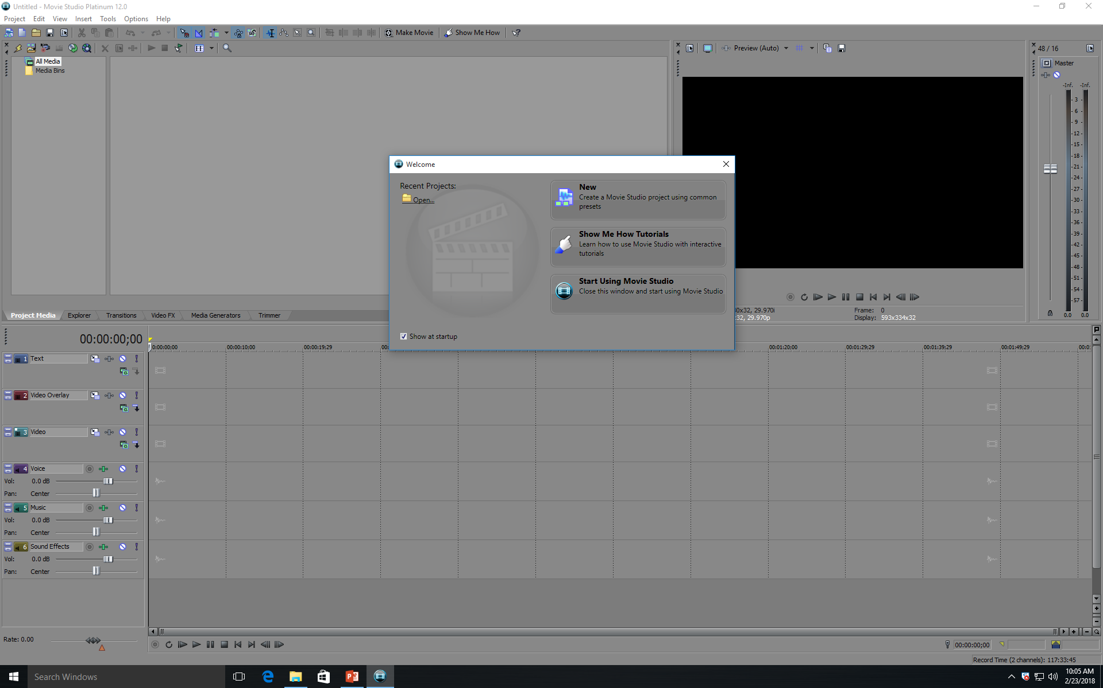
When you open movie studio platinum, you will see this:
Click “new”

Slide 3
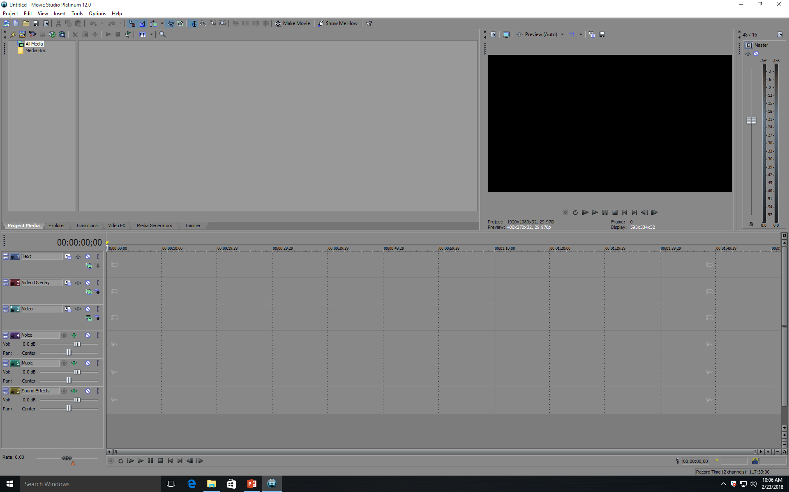
Parts
This is the preview screen, where you can view what you have created
This is where you can change the volume of your project.
This is where you find the “media” (everything you will add to your project).
This is where you find the “media” (everything you will add to your project).
This is the timeline, where you add video, text, audio, and more.
These are the tracks where you place the media
These are the tracks where you place the media
These are the tracks where you place the media
These are the tracks where you place the media
These are the tracks where you place the media
These are the tracks where you place the media

Slide 4
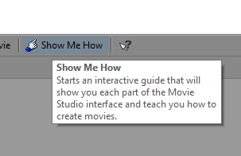
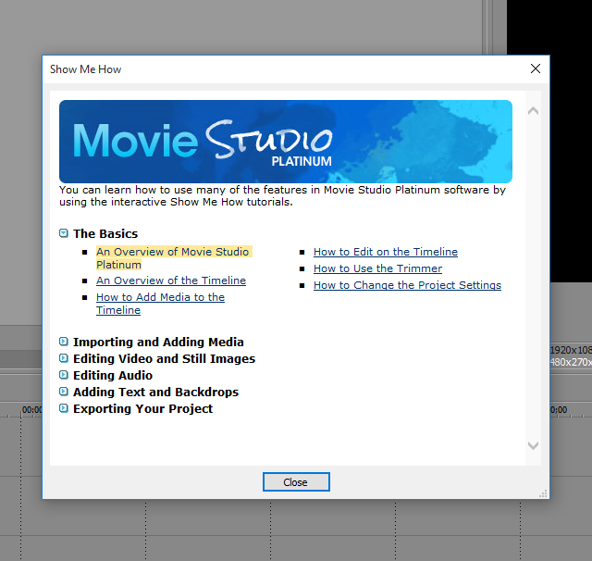
Show Me How
Then click on the first one under “the basics”. Feel free to watch any others too.
Click on the “show me how” tab at the top.

Slide 5
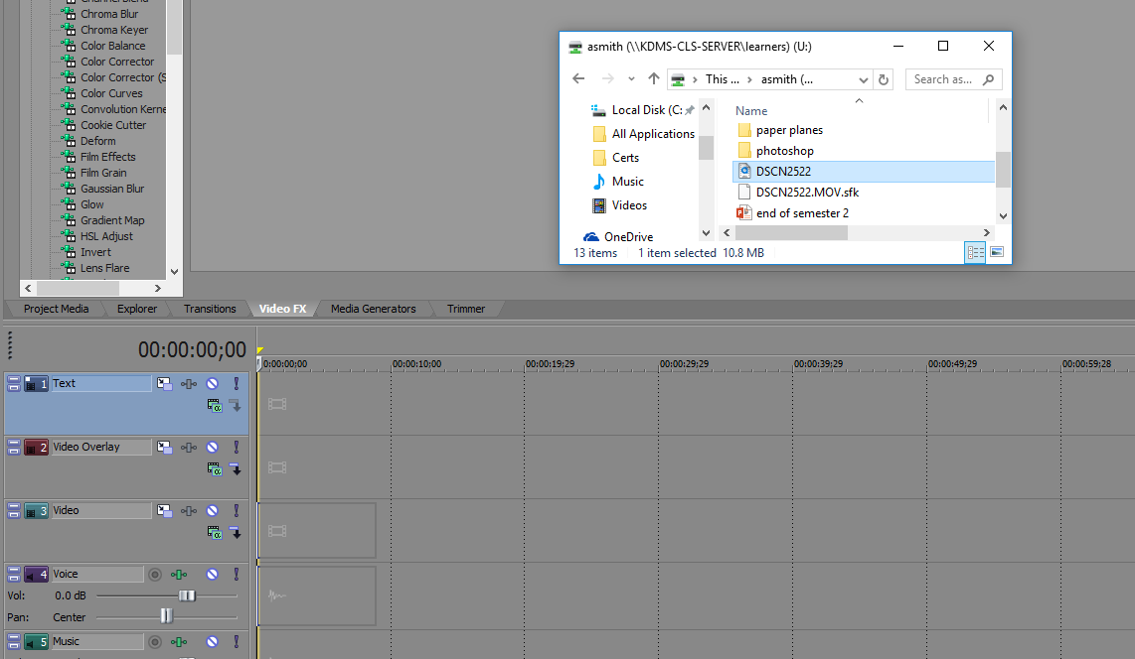
Audio and Video
To add video and audio, simply drag the audio or video file on to the timeline.

Slide 6
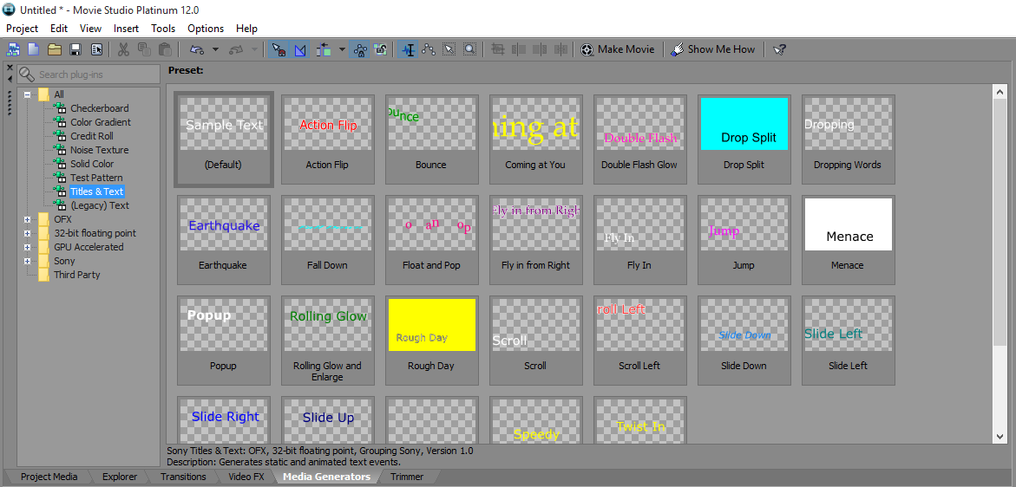
Text, Credits, and effects
To add text or credits, go to “media generators”, click Titles and text or credit roll, pick the effect you want, drag it to the timeline, then type in the text you want. You can do this with any other effects too.

Slide 7
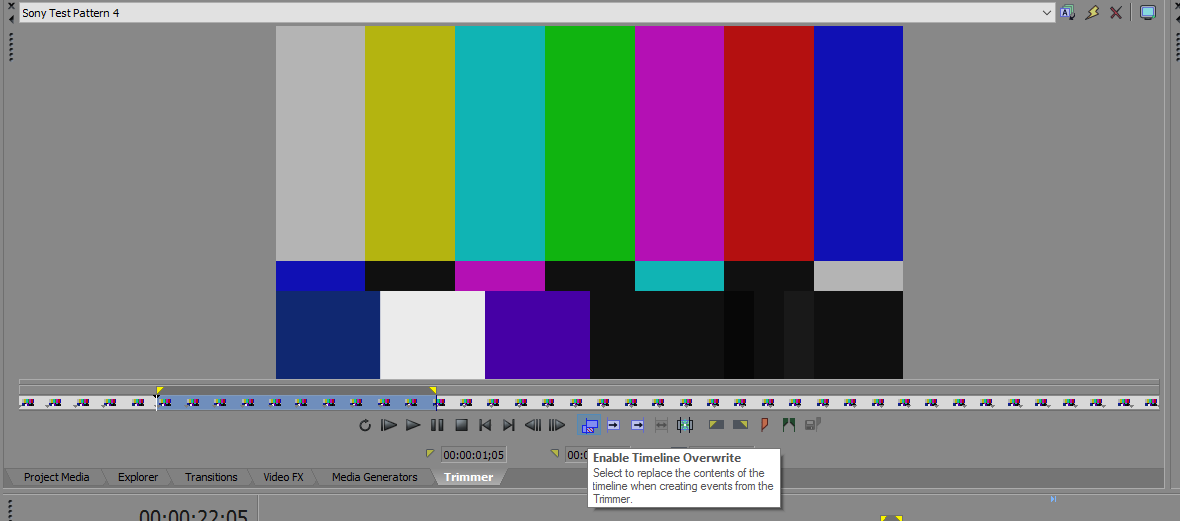
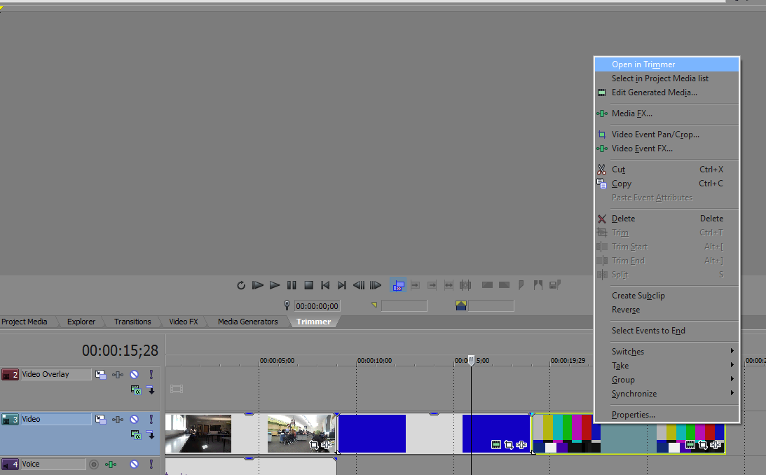
Trimmer
This is the trimmer, it is at the top left of the screen.
To use the trimmer, right-click what you want to be trimmed then select “open in trimmer”.
Select what you want to keep with the yellow tabs.
Then click “enable timeline overwrite.

Slide 8
Try it yourself
If you are having trouble, remember to use the “show me how” tab.
Now try:
Adding video
Adding audio
Adding text
Adding credits
Trimming your video
Making your own video project!

